Slide 1
Semiconductor Diodes
Topic 1 (Chapter 1)

Slide 2
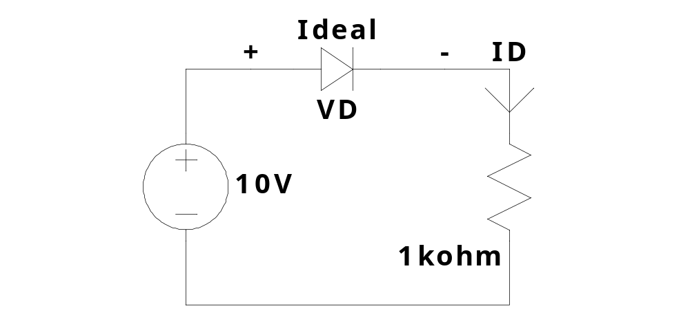
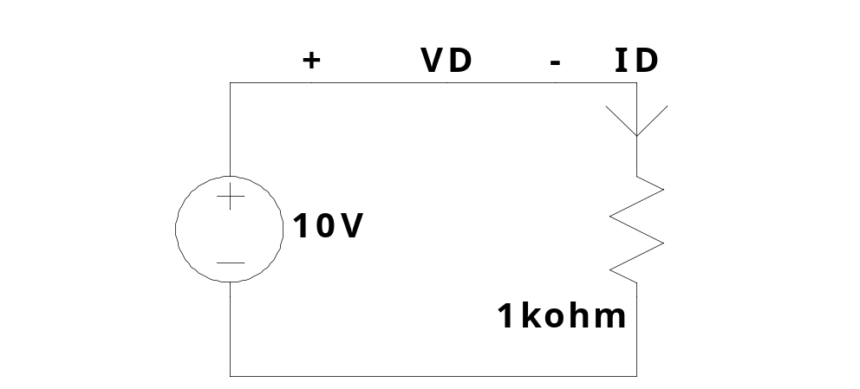
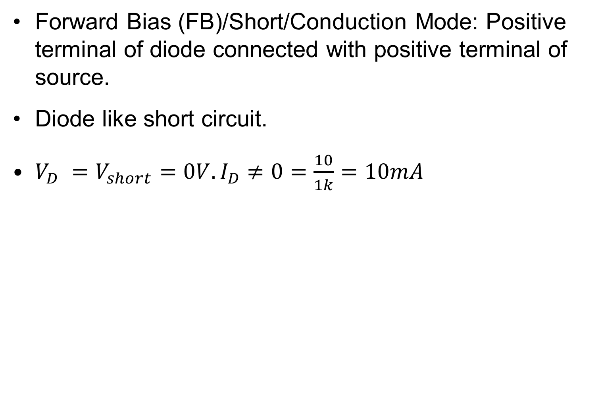
A simple Diode circuit
Forward Bias (FB)/Short/Conduction Mode: Positive terminal of diode connected with positive terminal of source.
Diode like short circuit.
$V_{D} =V_{short}=0V.I_{D}≠0=\frac{10}{1k}=10mA$

Slide 3
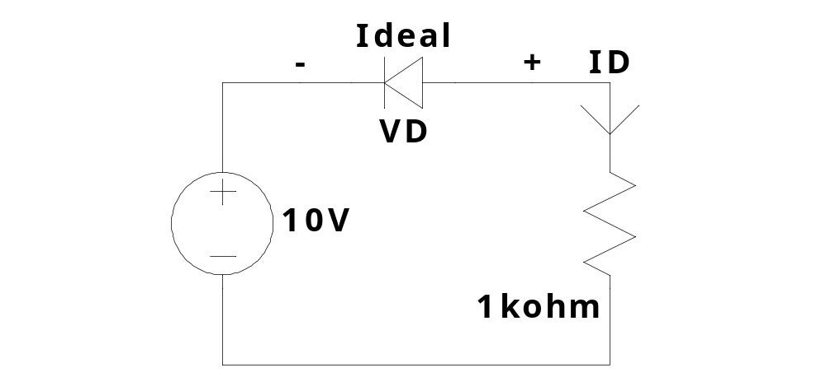
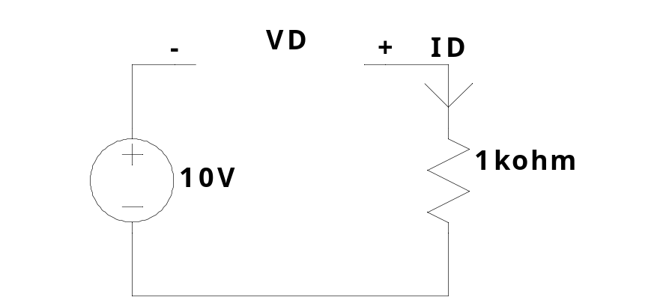
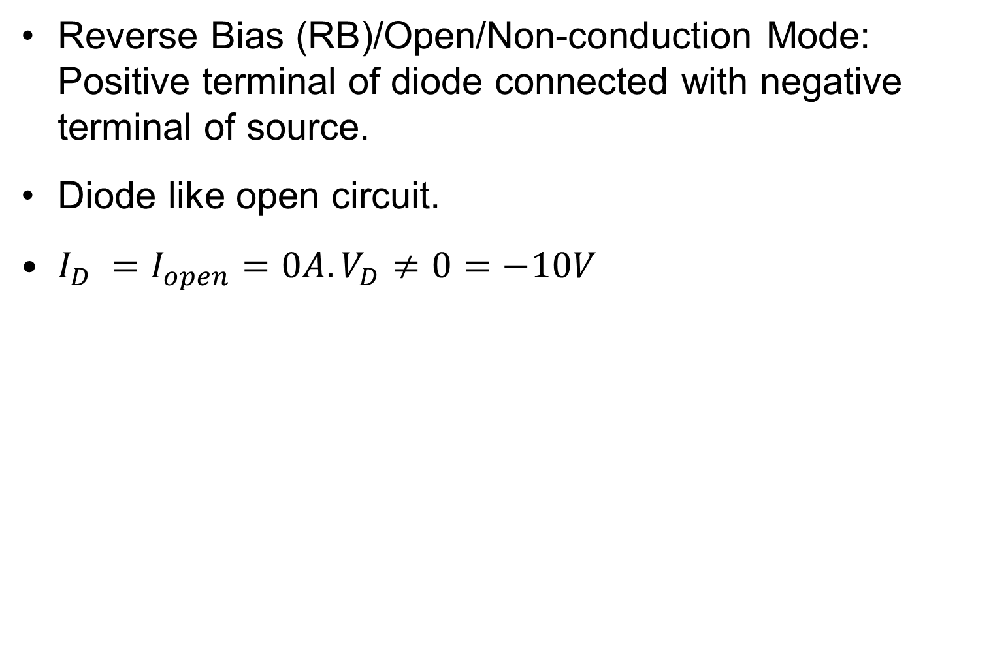
A simple Diode circuit
Reverse Bias (RB)/Open/Non-conduction Mode: Positive terminal of diode connected with negative terminal of source.
Diode like open circuit.
$I_{D} =I_{open}=0A.V_{D}≠0=−10V$

Slide 4
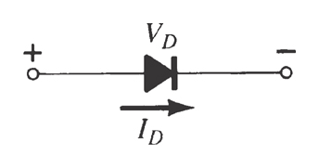
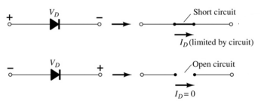
Diodes
The diode is a 2-terminal device.
A diode ideally conducts in only one direction.

Slide 5
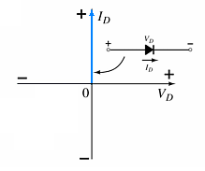
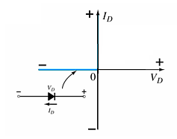
Diode Characteristics
Conduction Region
Non-Conduction Region
The voltage across the diode is 0 V
The diode acts like a short
All of the voltage is across the diode
The current is 0 A
The diode acts like open

Slide 6
1.2 Semiconductor Materials
Materials commonly used in the development of semiconductor devices:
Silicon (Si)
Germanium (Ge)
Gallium Arsenide (GaAs)

Slide 7
What are Semiconductors?
Semiconductors are a group of materials having electrical conductivities intermediate between metals (conductors) and insulators.
Their conductivities can be varied by changes in:
  temperature,
  impurity content.

Slide 8
History of Popular Semiconductors
Ge (Germanium) was widely used in the early days.
Si (Silicon) is now used for the majority of integrated circuits (ICs).
The compound semiconductors are widely used in high- speed devices and opto-electronic devices
  For example, III–V semiconductors such as GaN, GaP, and GaAs are common in light- emitting diodes (LEDs)
Three-element or ternary semiconductors (such as GaAsP) and four-element or quaternary semiconductors (such as InGaAsP) are also used.
  For example, they can be used to make LEDs of different colors.

Slide 9
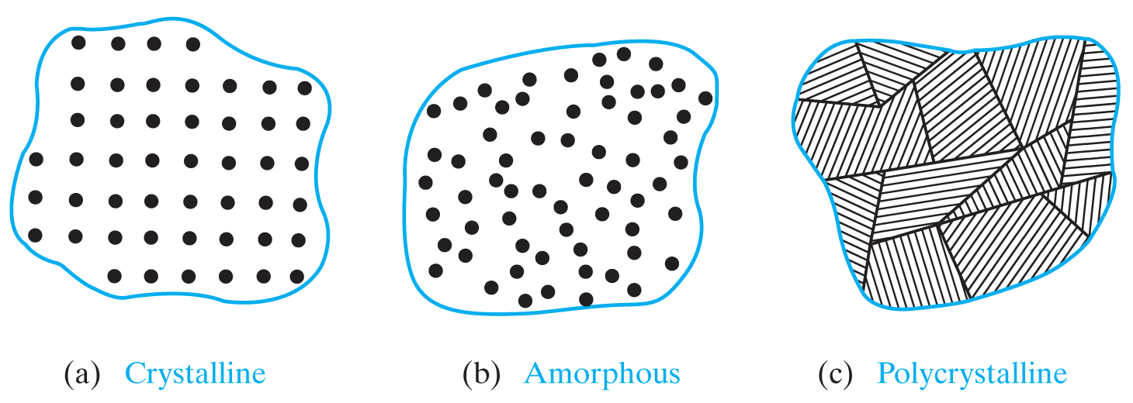
Three types of solids
Solids are classified according to their atomic arrangement:
  Crystalline: the atoms are arranged in a periodic fashion
  Amorphous: no periodic structure at all
  Polycrystalline: many small regions of single-crystal material

Slide 10
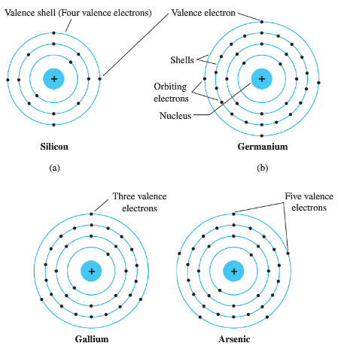
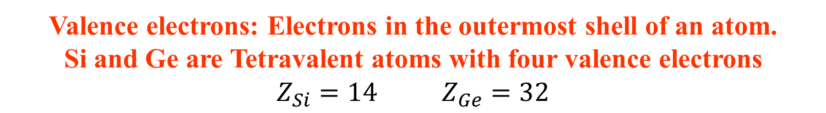
1.3 Atomic Structures of
Semiconductors
Valence electrons: Electrons in the outermost shell of an atom.
Si and Ge are Tetravalent atoms with four valence electrons
$Z_{Si}=14$ $Z_{Ge}=32$

Slide 11
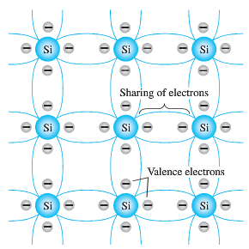
Covalent bonding of the silicon atom

Slide 12
Silicon atoms in a crystal share electrons.
Valence saturation: n = 8
Because the valence electrons are bound, a silicon
crystal at room temperature is almost a perfect insulator.

Slide 13
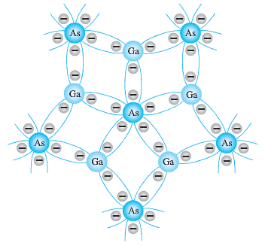
Covalent bonding of the GaAs crystal

Slide 14
Intrinsic Semiconductors
Semiconductor materials two types:
Intrinsic Semiconductors
Extrinsic Semiconductors
A pure semiconductor
Carefully refined to reduce the number of impurities to a very low level
Intrinsic carriers: free electrons in a material due only to external causes (energy from light or heat)

Slide 15
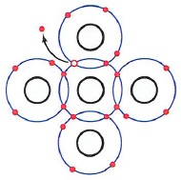
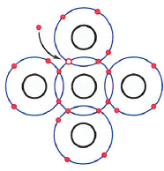
Electron Hole Pair Generation and Recombination
Valence electrons can absorb sufficient energy (from light or heat) to break the covalent bonds and assume the “free” state.
  These free electrons are called intrinsic carriers
Higher temperatures creates more intrinsic carriers – hence higher conductivity

Slide 16
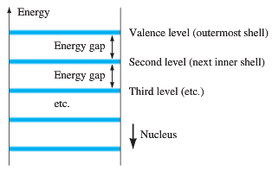
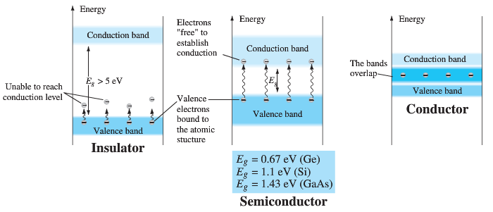
1.4 ENERGY LEVELS
(a) Discrete energy levels in isolated atomic structures
The farther an electron is from the nucleus, the higher is the energy state
(b) conduction and valence bands of an insulator, a semiconductor, and a conductor.

Slide 17
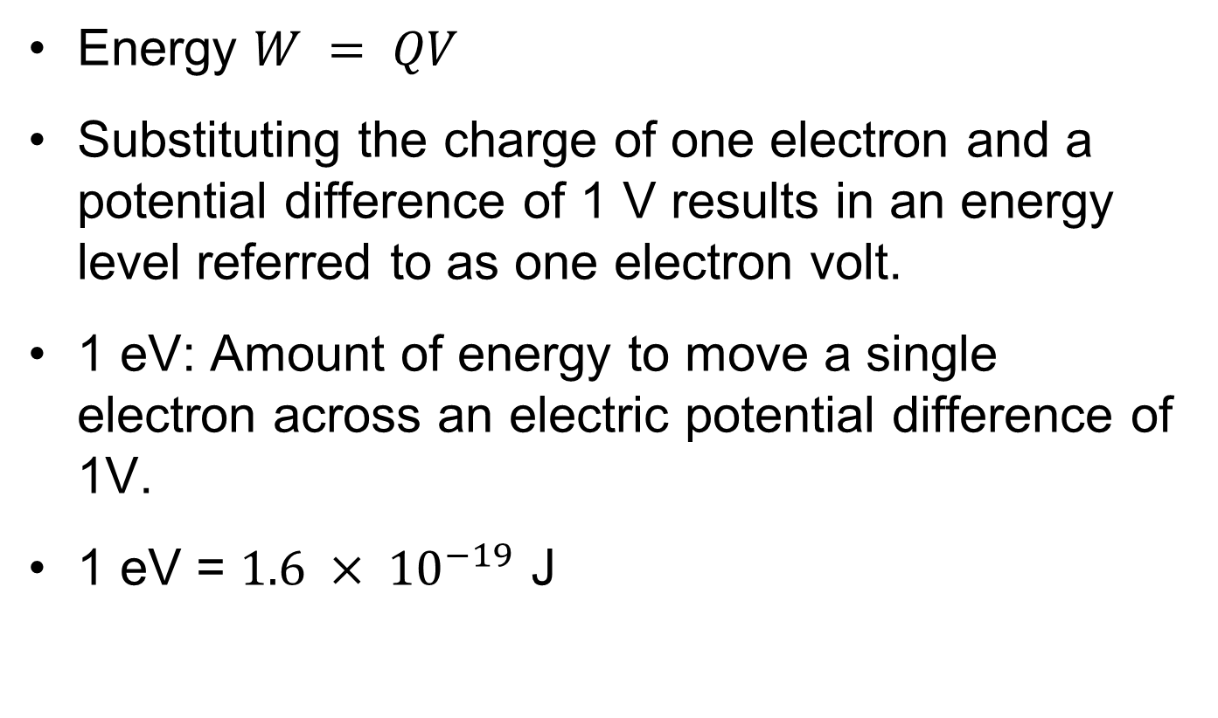
Electron volts (eV)
Energy $W = QV$
Substituting the charge of one electron and a potential difference of 1 V results in an energy level referred to as one electron volt.
1 eV: Amount of energy to move a single electron across an electric potential difference of 1V.
1 eV = $1.6 × {10}^{−19}$ J

Slide 18
1.5 n-TYPE AND p-TYPE MATERIALS
The electrical properties of a semiconductor can be altered significantly by adding impurity atoms
  This process is called doping
  A doped semiconductor is called extrinsic
There are just two types of extrinsic semiconductor materials:
n-type p-type
n-type materials contain an excess of conduction band electrons.
p-type materials contain an excess of valence band holes.

Slide 19
Atomic Structures of Impurities
p-type material is created by adding trivalent impurity elements such as B, Ga, and In
n-type material is created by adding pentavalent impurity elements such as Sb, As, and P

Slide 20
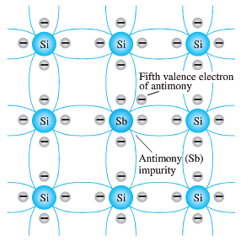
n -Type Material
Antimony impurity in n-type material.
Impurities with five valence electrons (pentavalent) are called donor atoms, because the inserted impurity atom has donated a relatively “free” electron to the structure

Slide 21
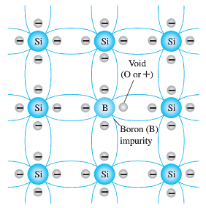
p-Type Material
Boron impurity in p-type material.
There is now an insufficient number of electrons to complete the covalent bonds of the newly formed lattice.
  The resulting vacancy is called a hole
The diffused impurities with three valence electrons are called acceptor atoms, because the resulting vacancy will readily accept a free electron

Slide 22
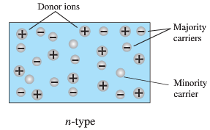
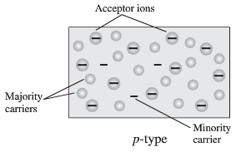
Majority and Minority Carriers
In an n-type material, the electron is called the majority carrier and the hole the minority carrier.
In a p-type material, the hole is called the majority carrier and the electron the minority carrier

Slide 23
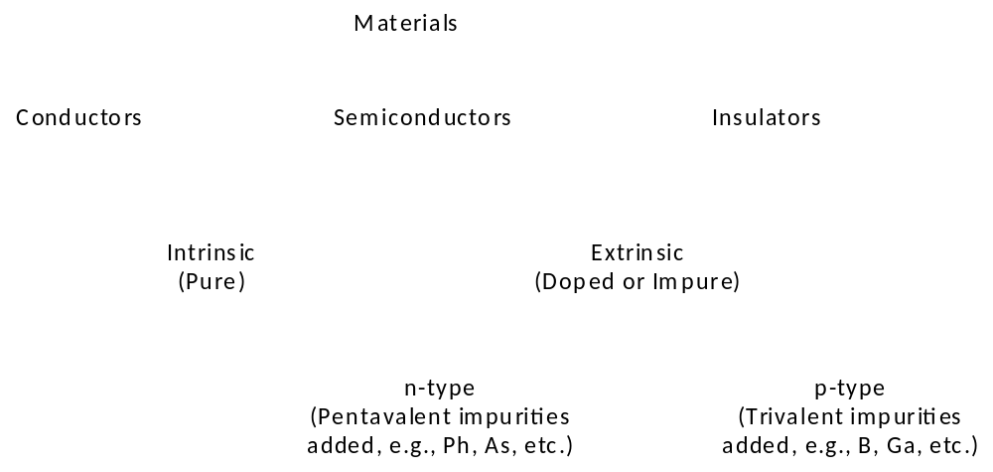
Electrical Classification of Materials

Slide 24
Semiconductors in Summary
The most popular material is silicon.
Pure crystals are intrinsic semiconductors.
Doped crystals are extrinsic semiconductors.
Crystals are doped to be n type or p type.
A doped semiconductor will have mostly majority carriers and a few thermally generated minority carriers.
  Electrons are majority carriers in n type
  Holes are majority carriers in p type

Slide 25
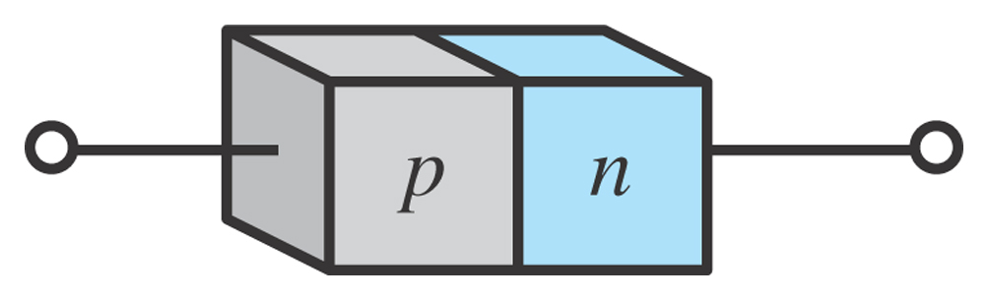
1.6 p-n Junctions
One end of a silicon or germanium crystal can be doped as a p-type material and the other end as an n-type material.
The result is a p-n junction or Semiconductor Diode

Slide 26
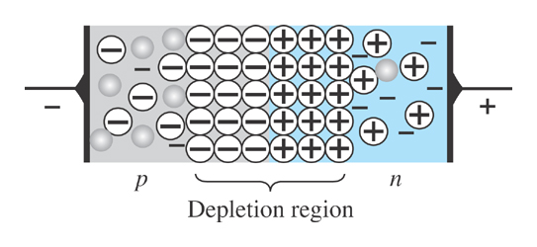
p-n Junctions
At the p-n junction, the excess conduction-band electrons on the n-type side are attracted to the valence-band holes on the p-type side.
The electrons in the n-type material migrate across the junction to the p-type material (electron flow).
Electron migration results in a negative charge on the p-type side of the junction and a positive charge on the n-type side of the junction.
The result is the formation of a depletion region around the junction.

Slide 27
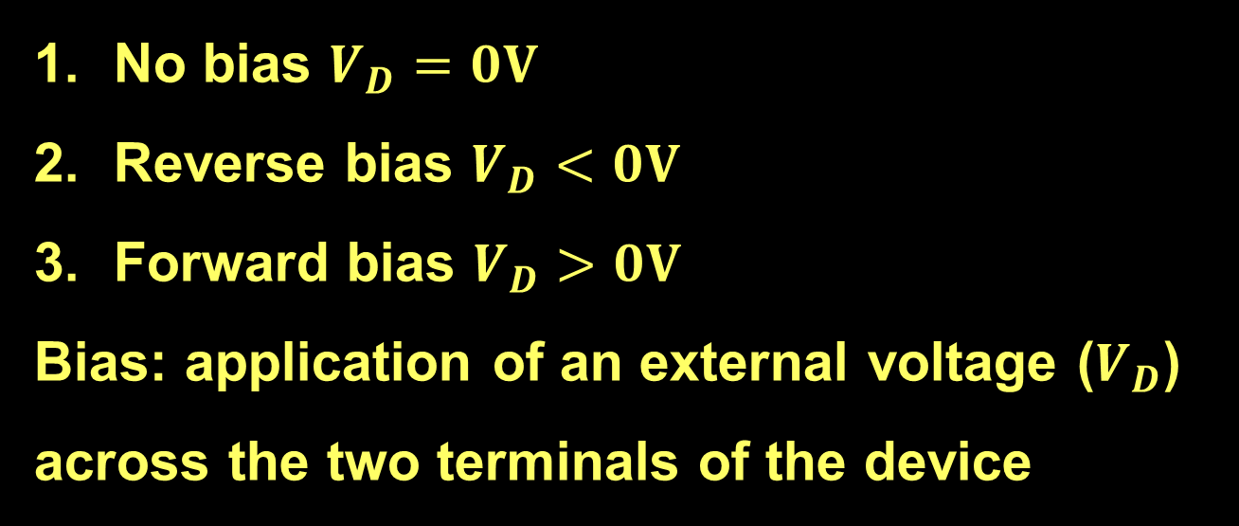
Diode Operating Conditions
A diode has three operating conditions:
No bias $V_{D}=0V$
Reverse bias $V_{D}<0V$
Forward bias $V_{D}>0V$
Bias: application of an external voltage ($V_{D}$) across the two terminals of the device

Slide 28
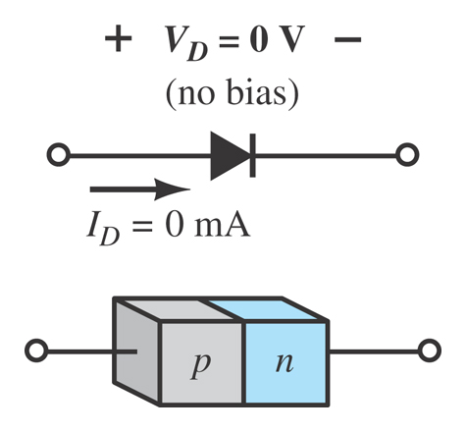
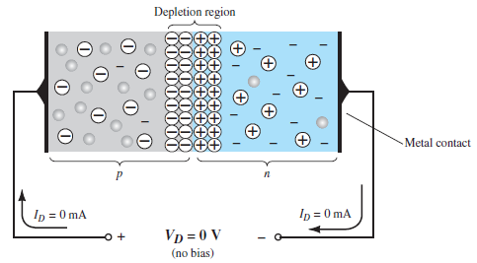
Diode Operating Conditions
No Bias
No external voltage is applied: V_{D} = 0 V
There is no diode current: I_{D} = 0 A
Only a modest depletion region exists

Slide 29
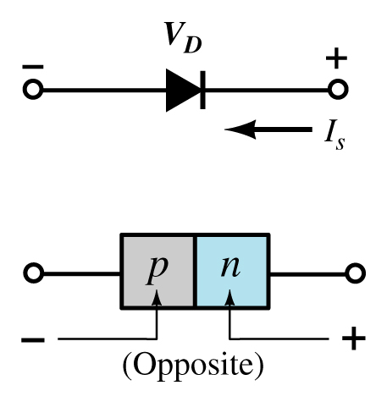
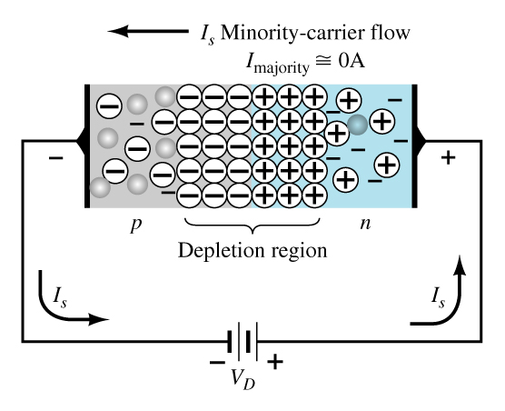
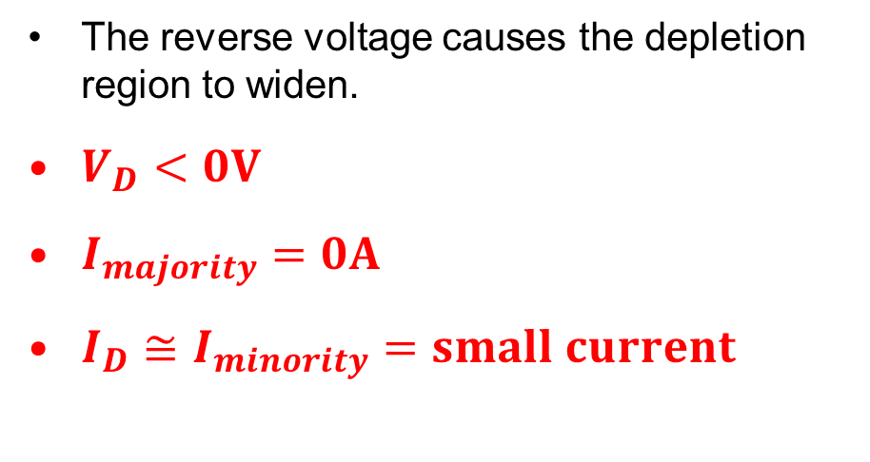
Diode Operating Conditions
Reverse Bias
External voltage is applied across the p-n junction in the opposite polarity of the p- and n-type materials.
The reverse voltage causes the depletion region to widen.
$V_{D}<0V$
$I_{majority}=0A$
$I_{D}≅I_{minority}=small current$

Slide 30
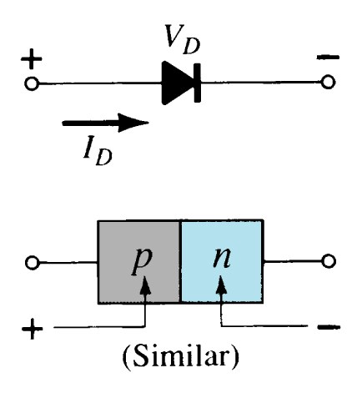
Diode Operating Conditions
Forward Bias
External voltage is applied across the p-n junction in the same polarity as the p- and n-type materials.

Slide 31
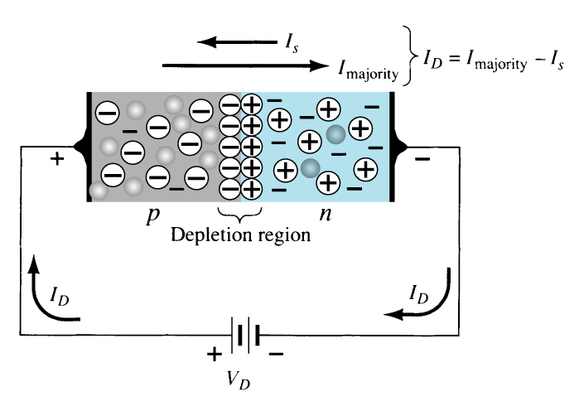
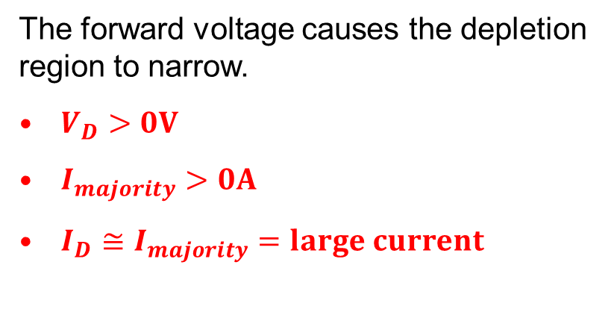
Diode Operating Conditions
Forward Bias
The forward voltage causes the depletion region to narrow.
$V_{D}>0V$
$I_{majority}>0A$
$I_{D}≅I_{majority}=large current$
The electrons and holes are pushed toward the p-n junction.
The electrons and holes have sufficient energy to cross the p-n junction.

Slide 32
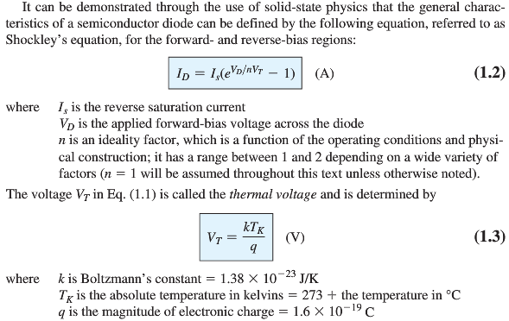
Diode Current Equation

Slide 33

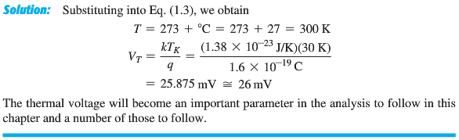

Slide 34
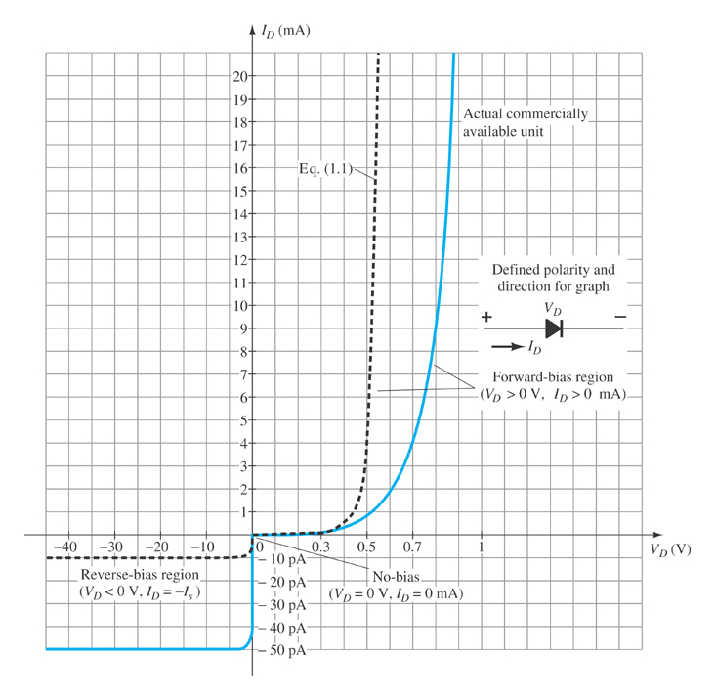
Actual/Practical Diode Characteristics
Note the regions for no bias, reverse bias, and forward bias conditions.
Carefully note the scale for each of these conditions.

Slide 35
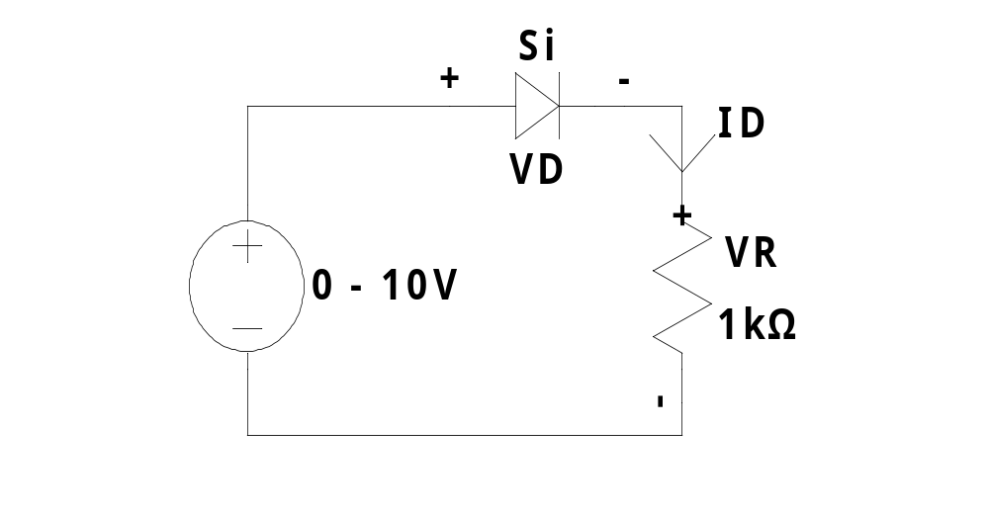
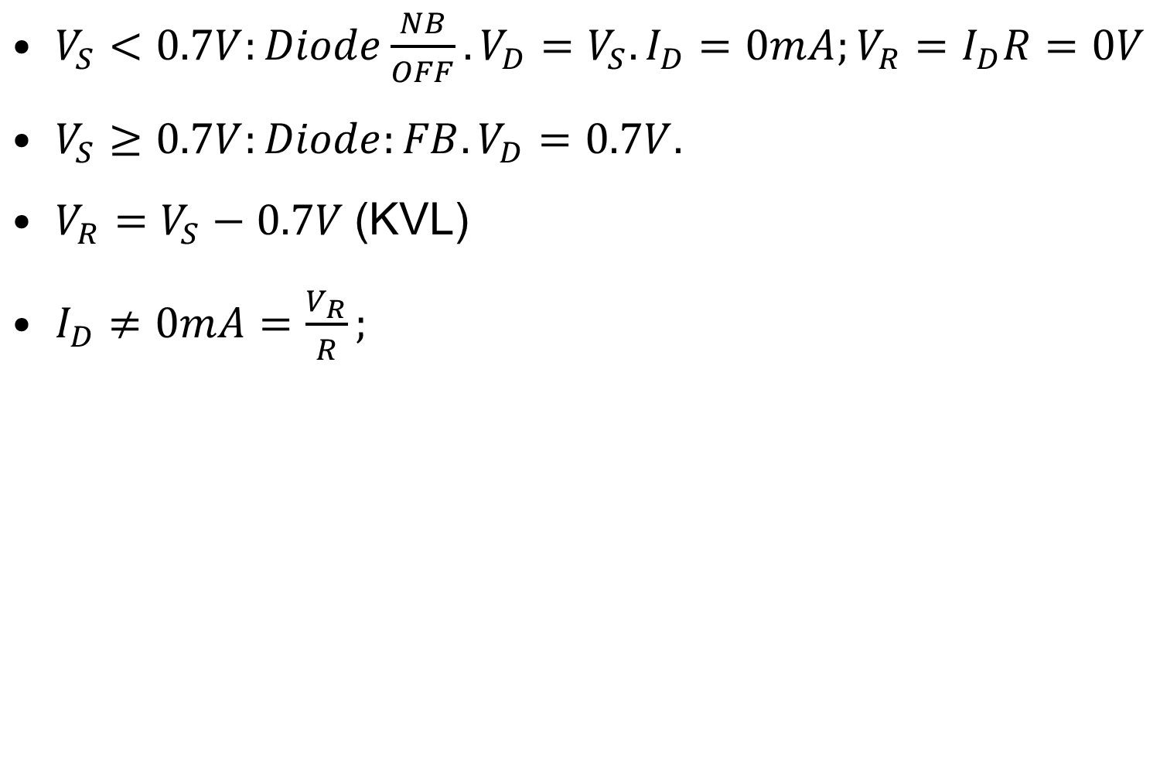
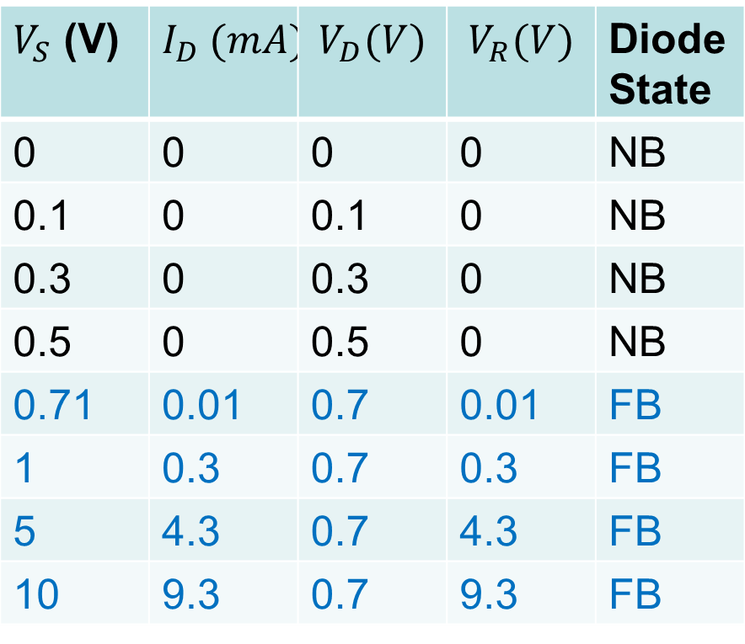
Forward Bias (FB)/Short/Conduction Mode
$V_{S}<0.7V:Diode\frac{NB}{OFF}.V_{D}=V_{S}.I_{D}=0mA;V_{R}=I_{D}R=0V$
$V_{S}≥0.7V:Diode:FB.V_{D}=0.7V.$
$V_{R}=V_{S}−0.7V$ (KVL)
$I_{D}≠0mA=\frac{V_{R}}{R};$
$V_{S}$ (V) | $$I_{D} (mA)$$ | $$V_{D}(V)$$ | $$V_{R}(V)$$ | Diode State
0 | 0 | 0 | 0 | NB
0.1 | 0 | 0.1 | 0 | NB
0.3 | 0 | 0.3 | 0 | NB
0.5 | 0 | 0.5 | 0 | NB
0.71 | 0.01 | 0.7 | 0.01 | FB
1 | 0.3 | 0.7 | 0.3 | FB
5 | 4.3 | 0.7 | 4.3 | FB
10 | 9.3 | 0.7 | 9.3 | FB

Slide 36

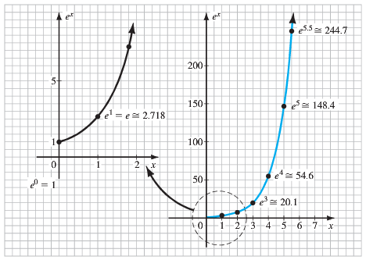
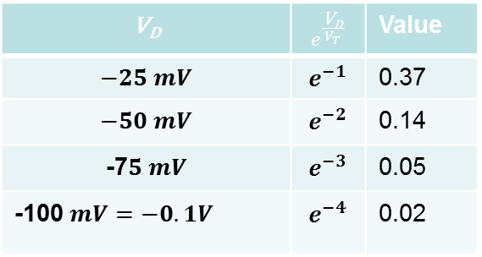
Diode Current Approximations
V_{D} |  | Value
 |  | 0.37
 |  | 0.14
 |  | 0.05
 |  | 0.02

Slide 37
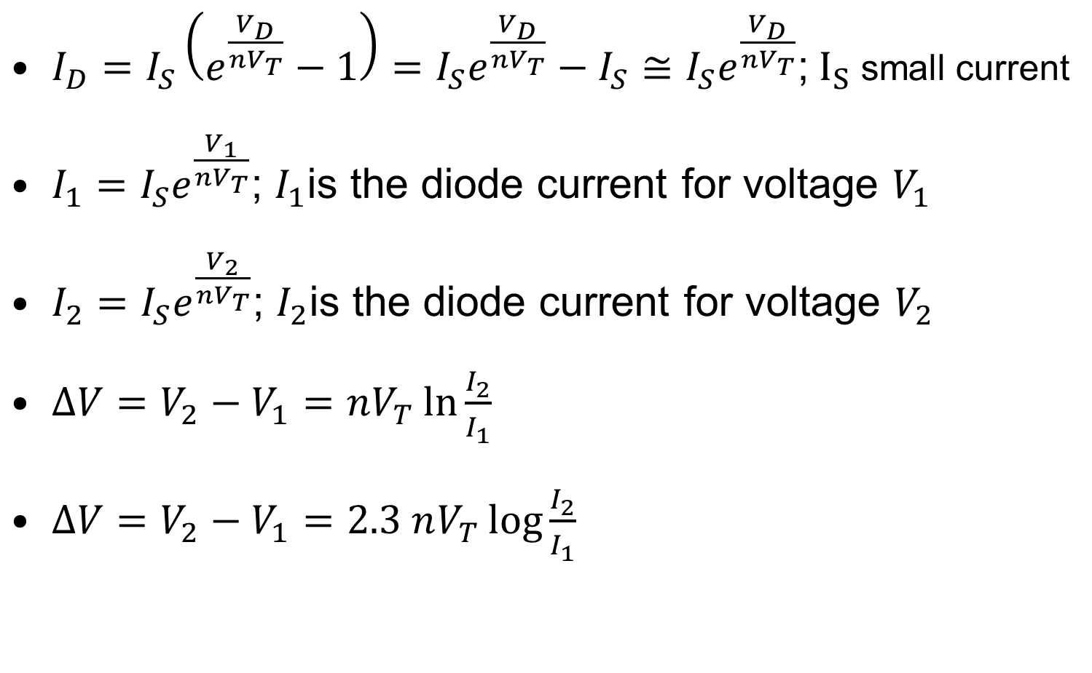
Forward bias condition
$I_{D}=I_{S}\left(e^{\frac{V_{D}}{nV_{T}}}−1\right)=I_{S}e^{\frac{V_{D}}{nV_{T}}}−I_{S}≅I_{S}e^{\frac{V_{D}}{nV_{T}}}$; $I_{S}$ small current
$I_{1}=I_{S}e^{\frac{V_{1}}{nV_{T}}}$; $I_{1}$is the diode current for voltage $V_{1}$
$I_{2}=I_{S}e^{\frac{V_{2}}{nV_{T}}}$; $I_{2}$is the diode current for voltage $V_{2}$
$∆V=V_{2}−V_{1}=nV_{T}\ln{\frac{I_{2}}{I_{1}}}$
$∆V=V_{2}−V_{1}=2.3 nV_{T}\log{\frac{I_{2}}{I_{1}}}$

Slide 38
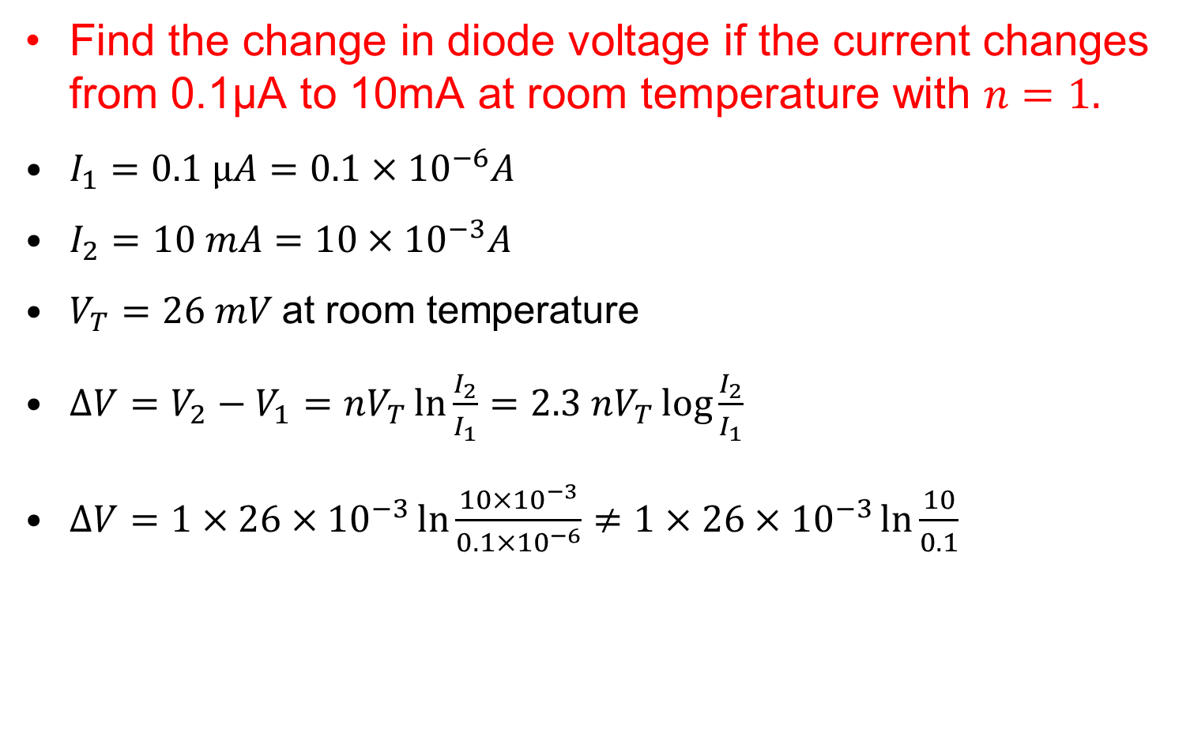
Forward bias condition
Find the change in diode voltage if the current changes from 0.1μA to 10mA at room temperature with $n=1.$
$I_{1}=0.1 μA=0.1×{10}^{−6}A$
$I_{2}=10 mA=10×{10}^{−3}A$
$V_{T}=26 mV$ at room temperature
$∆V=V_{2}−V_{1}=nV_{T}\ln{\frac{I_{2}}{I_{1}}}=2.3 nV_{T}\log{\frac{I_{2}}{I_{1}}}$
$∆V=1×26×{10}^{−3}\ln{\frac{10×{10}^{−3}}{0.1×{10}^{−6}}}≠1×26×{10}^{−3}\ln{\frac{10}{0.1}}$

Slide 39
Majority and Minority Carriers
Two currents through a diode:
Majority Carriers
The majority carriers in n-type materials are electrons.
The majority carriers in p-type materials are holes.
Minority Carriers
The minority carriers in n-type materials are holes.
The minority carriers in p-type materials are electrons.

Slide 40
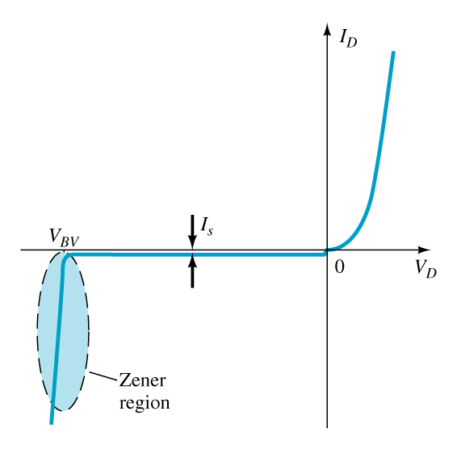
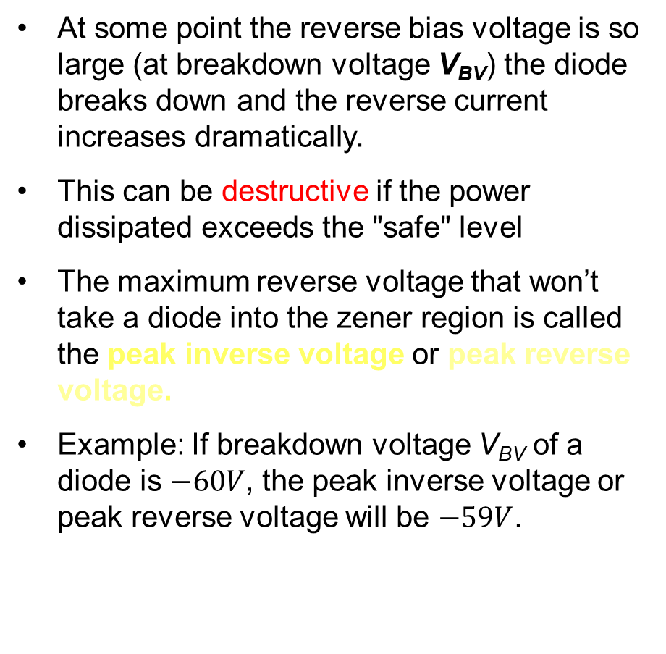
Breakdown Region
The breakdown region is in the diode’s reverse-bias region.
At some point the reverse bias voltage is so large (at breakdown voltage V_{BV}) the diode breaks down and the reverse current increases dramatically.
This can be destructive if the power dissipated exceeds the "safe" level
The maximum reverse voltage that won’t take a diode into the zener region is called the peak inverse voltage or peak reverse voltage.
Example: If breakdown voltage V_{BV} of a diode is $−60V$, the peak inverse voltage or peak reverse voltage will be $−59V$.

Slide 41
Forward Bias Voltage/ Threshold Voltage/ Knee Voltage
The point at which the diode changes from no-bias condition to forward-bias condition occurs when the electrons and holes are given sufficient energy to cross the p-n junction. This energy comes from the external voltage applied across the diode.
The forward bias voltage required for a:
gallium arsenide (GaAs) diode ≅ 1.2 V silicon (Si) diode ≅ 0.7 V germanium (Ge) diode ≅ 0.3 V

Slide 42
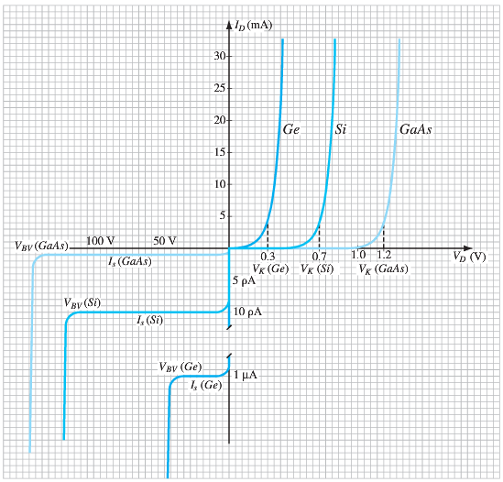
Comparison of Ge, Si, and GaAs diodes

Slide 43
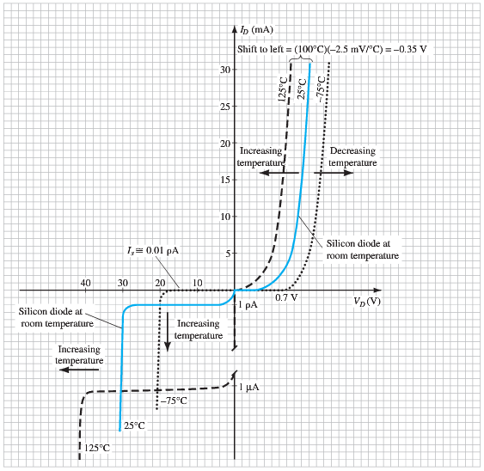
Temperature Effects
As temperature increases it adds energy to the diode.
  It reduces the required forward bias voltage
  It increases the amount of reverse current and reverse breakdown voltage.
The reverse current of a silicon diode doubles for every 10°C rise in temp.
Germanium diodes are more sensitive to temperature variations than silicon or gallium arsenide diodes.

Slide 44
Other Types of Diodes
There are several types of diodes besides the standard p-n junction diode. Three of the more common are:
Zener diodes
Light-emitting diodes (LED)

Slide 45


1.15 Zener Diode
A Zener diode is one that is designed to safely operate in its zener region; i.e., biased at the Zener voltage (V_{Z}).
FB region: same as semiconductor diodes.
Breakdown/Zener region: Different from semiconductor diodes.
Common Zener diode voltage ratings are between 1.8V and 200V.
Higher doping than the semiconductor diodes.

Slide 46


Zener Diode Characteristics
Typical specifications for a 10-V, 500-mW, 20% Zener diode
Expected to vary as 10 V + 20%, or from 8 V to 12 V.
Both 10% and 50% diodes are also readily available.

Slide 47

1.16 Light-Emitting Diode (LED)
An LED emits light when it is forward biased, which can be in the infrared or visible spectrum.
LED and semiconductor diodes work exactly similar in reverse bias region.
The forward bias voltage is usually in the range of 1.5 V to 2.5 V.

Slide 48

Light-Emitting Diodes

Slide 49
Causes of Light in LEDs
In a forward-biased LED, free electrons cross the junction and fall into holes
  As these electrons fall from a higher to a lower energy level, they radiate energy
  In an LED, the energy is radiated as light
  The color of the light depends on the bandgap of the diode material

Slide 50
1.8 Resistance Levels
Semiconductors react differently to DC and AC currents.
There are three types of resistance:
DC (static) resistance
AC (dynamic) resistance
Average AC resistance

Slide 51


DC (Static) Resistance
For a specific applied DC voltage (V_{D}) the diode has a specific current (I_{D}) and a specific resistance (R_{D}).

Slide 52




Slide 53




AC (Dynamic) Resistance
In the forward bias region: $r_{d}= \frac{nV_{T}}{I_{D}}$
The resistance r_{d} depends on the amount of current (I_{D}) in the diode.

Slide 54


Analytical Derivation of r_{d}

Slide 55


Total AC (Dynamic) Resistance
The total ac resistance r'_{d} includes r_{B}, which is the resistance of the semiconductor material itself (called body resistance) and the resistance introduced by the connection between the semiconductor material and the external metallic conductor (called contact resistance).
r_{B} ranges from a typical 0.1 Ω for high power devices to 2 Ω for low power, general purpose diodes. In some cases r_{B} can be ignored.
In the reverse bias region:
The resistance is effectively infinite. The diode acts like an open.

Slide 56


Average AC Resistance
AC resistance can be calculated using the current and voltage values for two points on the diode characteristic curve.

Slide 57

Summary Table

Slide 58


1.9 Diode Equivalent Circuit
- Combination of properly chosen elements to represent the actual characteristics of a device.

Slide 59

Summary Table
3rd Approximation
2nd Approximation
1st Approximation

Slide 60
Practice Problem
Use 11th edition of the textbook
Total points: 100 (10 each)
Problems:
  Chapter 1: 15, 16, 18, 19, 27, 28, 29, 31

Slide 61
Quiz 1
Syllabus:
  Chapter 1

Slide 62
Quiz 1
Quiz 1 11/09/2020 Wednesday ??
Syllabus: Chapter 1 Semiconductor Diodes
There will be 1 math problem + Short questions/MCQs/True False.
Math Problem from Diode Current Equation (Slides: 30,31 & 34) OR AC Resistance (Slide 50).

Slide 63
1. Draw V-I characteristics curve of an Ideal Diode or Semiconductor (Silicon/ Germanium) Diode.
2. What do you mean by intrinsic semiconductors?
3. What do you mean by extrinsic semiconductors?
4. What are the majority and minority carriers of p-type and n-type materials?
5. What happens in a semiconductor diode in no bias condition?
6. What happens in a semiconductor diode in the forward bias condition?
7. What is break down/ Zener voltage? What is peak inverse voltage (PIV)?
8. What is forward bias voltage/knee voltage?
9. Draw the symbol of a semiconductor diode, Zener diode, and LED.
10. What are the differences between semiconductor (Si) diode and Zener diode?

